Slide 1
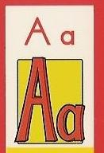
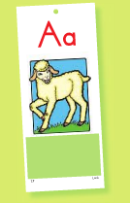
Pam the Lamb
I'm Pam the Lamb, I am.
This is how I tell my family where I am:
/a/ /a/ /a/ /a/ /a/

Slide 2
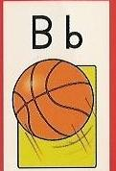
Bobby's Bouncing Ball
Bobby loves his basketball.
He bounces it all day.
The ball goes:
/b/ /b/ /b/ /b/ /b/
As it bounces on its way.

Slide 3
Carlos' Clicking Camera
Carlos clicks his camera:
/k/ /k/ /k/ /k/ /k/ it goes,
The pictures come out crisp and clear. So give a smile,
/k/ /k/ /k/ Carlos is here!

Slide 4
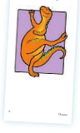
Dinah, the Dancing Dinosaur
Dinah, the Dancing Dinosaur, Had huge and clumsy feet. They went /d/ /d/ /d/ /d/ /d/ As Dinah kept the beat.

Slide 5
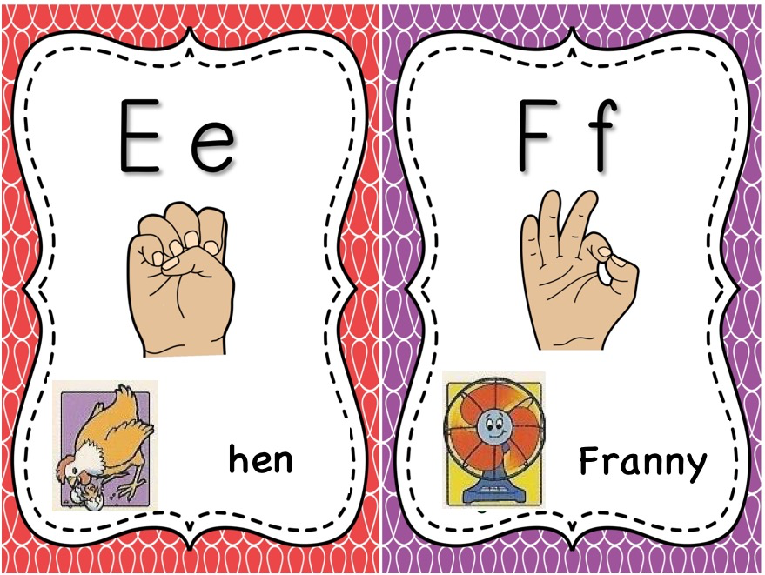
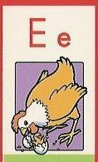
Jen's Pet Hen
Jen's pet hen likes to peck, peck, peck,
This is how her pecking sounds:
/e/ /e/ /e/ /e/ /e/

Slide 6
Franny the Fan
When Franny the fan goes round and round:
/f/ /f/ /f/ /f/ /f/ is her fast fan sound.

Slide 7
Gary the Gopher
Gary the gopher gulps green grapes all day.
When he gulps and gulps:
/g/ /g/ /g/ /g/ /g/ is what he'll say.

Slide 8
Harry the Hound Dog
Harry the Hound Dog Hurries around:
/h/ /h/ /h/ /h/ /h/ is his hurrying sound.

Slide 9
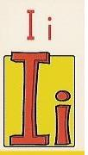
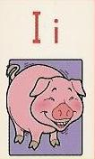
Pickles the Pig
Tickle Pickles the Pig,
And she'll get the giggles,
This is the sound of Pickles' giggles: /i/ /i/ /i/ /i/ /i/

Slide 10
Jenny's Jumprope
When Jenny jumps, her feet hit the ground:
/j/ /j/ /j/ /j/ /j/
Is the jumping-rope sound.

Slide 11
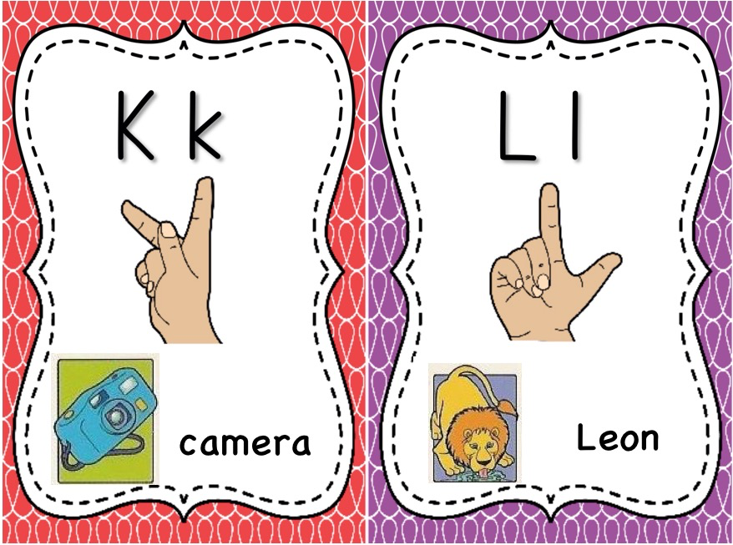
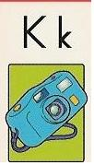
Carlos' Clicking Camera
Carlos clicks his camera:
/k/ /k/ /k/ /k/ /k/ it goes,
The pictures come out crisp and clear. So give a smile,
/k/ /k/ /k/ Carlos is here!

Slide 12
Leon the Lion
Leon the lion loves to lap water from lakes. This is the lapping sound Leon makes:
/l/ /l/ /l/ /l/ /l/ .

Slide 13
Muzzy the Monkey
Muzzy the Monkey thinks bananas are yummy,
She munches so many, they fill up her tummy
When she munches, she mumbles:
/m/ /m/ /m/ /m/ /m/.

Slide 14
Norman Newsome's Nose
Norman Newsome has a noisy nose. His nose is noisy because of the flu. He tries to sleep, but this is what his nose will do: /n/ /n/ /n/ /n/ /n/.

Slide 15
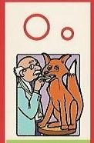
Bob the Fox
Bob the Fox did not feel well at all.
He hopped to the doctor's office. Say /o/ Mr. Fox: /o/ /o/ /o/ /o/ /o/
My head is hot and my throat hurts a lot,
Say /o/ Mr. Fox: /o/ /o/ /o/ /o/ /o/.

Slide 16
Ping and Pong's Popcorn
Ping and Pong popped popcorn in a pot:
/p /p/ /p/ /p/ /p/ was the sound it made when it was hot.

Slide 17
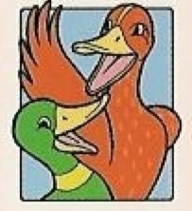
Quincy the Duck
Quincy the Duck couldn't quite quack, He said /kw/ /kw/ /kw/ /kw/ /kw/, But he left off the -ack!
Quincy kept trying, but all he could say was: /kw/ /kw/ /kw/ /kw/ /kw/.

Slide 18
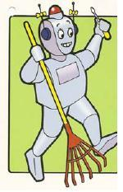
Rosie the Robot
Rosie the Robot just runs and runs to get her chores done: /r/ /r/ /r/ /r/ /r/.
Running here, running there, running almost everywhere: /r/ /r/ /r/ /r/ /r/.

Slide 19
Sue's Sizzling Sausages
Sue's sausages sizzle when hot:
/s/ /s/ /s/ /s/ /s/.
Sue eats sausages a lot.

Slide 20
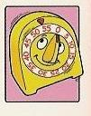
Tom Tuttle's Ticking Timer
Tom Tuttle's timer ticks like this:
/t/ /t/ /t/ /t/ /t/.
He sets his timer for tomatoes on toast,
Listen carefully: /t/ /t/ /t/ /t/ /t/.

Slide 21
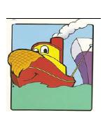
Tubby the Tugboat
Tubby the Tugboat can huff and puff And push and pull to move big stuff: /u/ /u/ /u/ /u/ /u/
That's the sound of Tubby the Tug. He works all day from dawn till dusk: /u/ /u/ /u/ /u/ /u/.

Slide 22
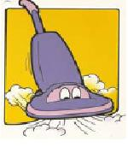
Vinny the Vacuum
Vinny the Vacuum is cleaning again. Before visitors visit, he always begins. This is the sound of his very loud voice:
/v/ /v/ /v/ /v/ /v/.
As he vacuums and vacuums all over the place:
/v/ /v/ /v/ /v/ /v/.

Slide 23
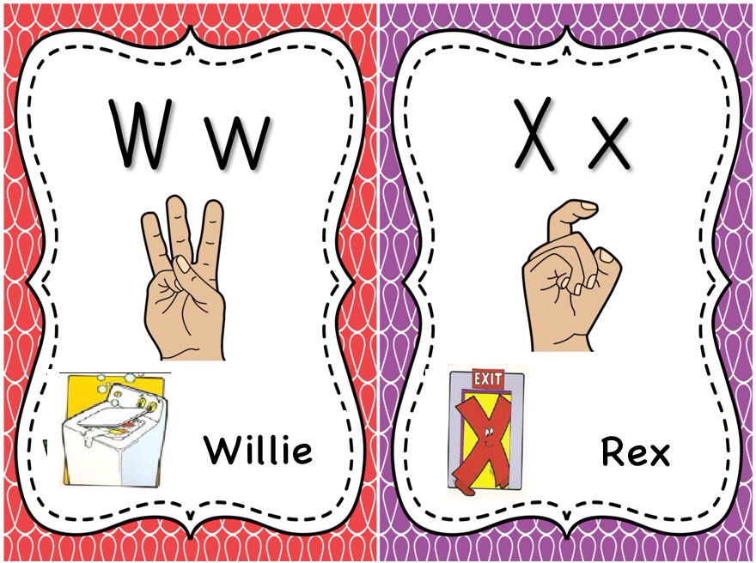
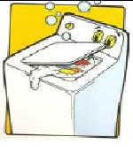
Willie the Washer
Willie the Washer washed clothes all week. When he washed he went:
/w/ /w/ /w/ /w/ /w/.
Willie the Washer was tired; he sprang a leak. He washed and he washed and he went: /w/ /w/ /w/ /w/ /w/.

Slide 24
Rex the Exiting X
Rex is called the Exiting X: He runs to guard the door. To get past Rex,
Make the sound of the X:
/ks/ /ks/ /ks/ /ks/ /ks/

Slide 25
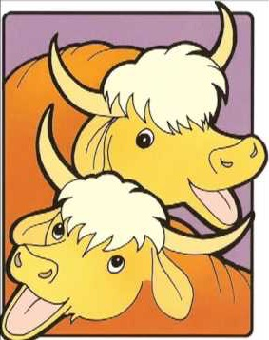
Yolanda the Yak
Yolanda is a yak.
She doesn't yell, she just yakety- yaks:
/y/ /y/ /y/ /y/ /y/.

Slide 26
Zack's Zipper
Zack's jacket has a zipper.
Zack zips it up and down and it makes this sound: /z/ /z/ /z/ /z/ /z/.

